Slide 1

ZPE-IMC
Zero-Point
Encoding
ZER
PA
Integrated Multimodal Multisensory Codec

Slide 2
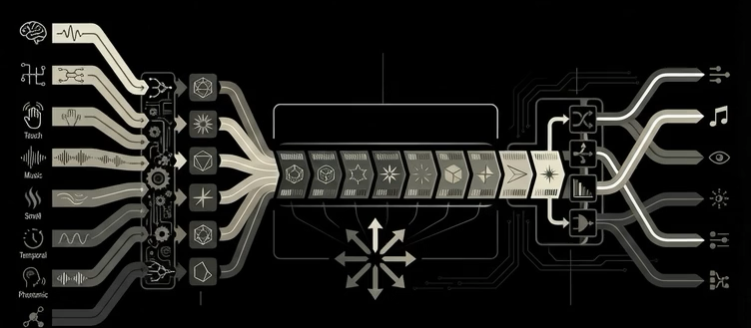
text
emojis
ZPE-IMC
diagrams
images
voice
music
taste
smell
mental
touch

Slide 3
ZER
PA
ZPE-IMC
One Codec…
…to rule them all

